Slide 1
User Manual
Axis System

Slide 2
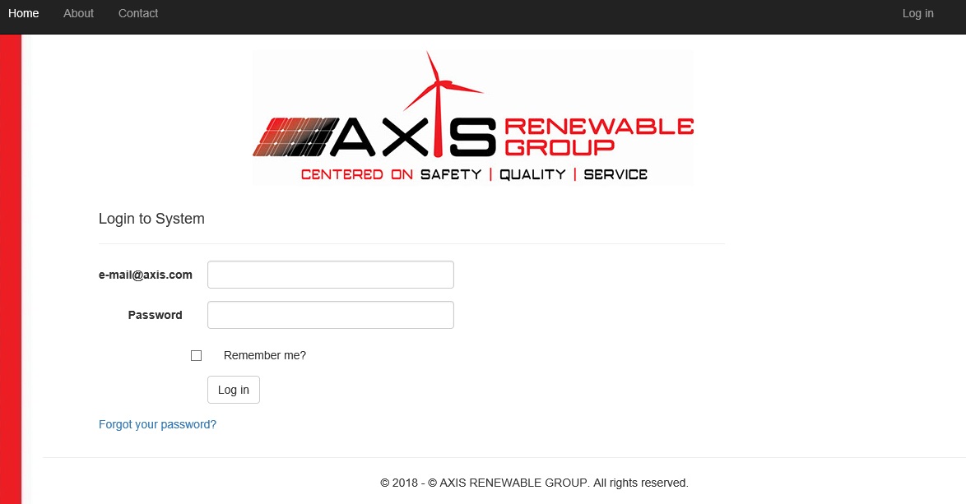
Access and change your passwork
Go to http://www.appsaxisrg.com/

Slide 3
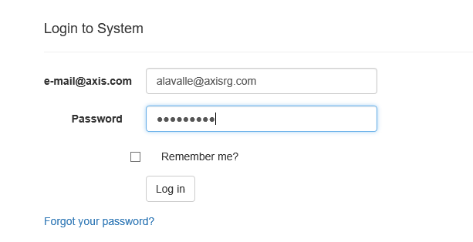
Type your user: example@axisrg.com
Defaul password: Prueba.2017
Click on “Log in” botton

Slide 4
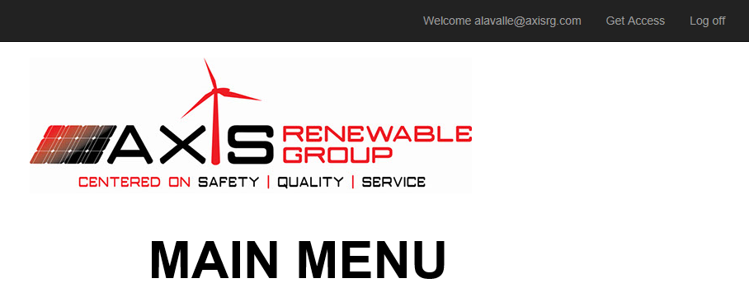
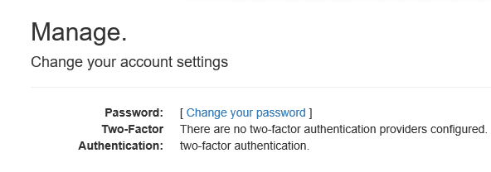
For change your password go to the top right and click on your user name

Slide 5
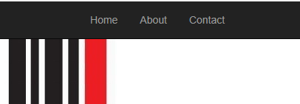

Go Main Menu

Slide 6
Module 1
Business Development

Slide 7
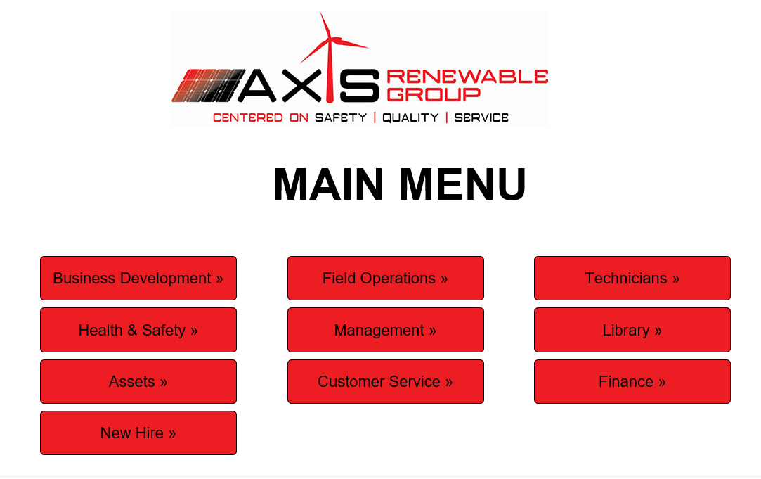
Go to Business Development button

Slide 8
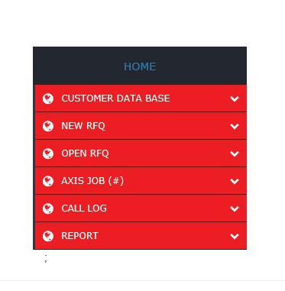
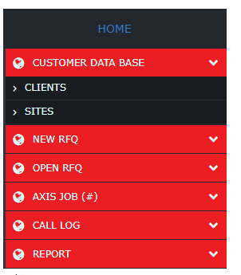
Business Development Menu
Clients
Customers register

Slide 9
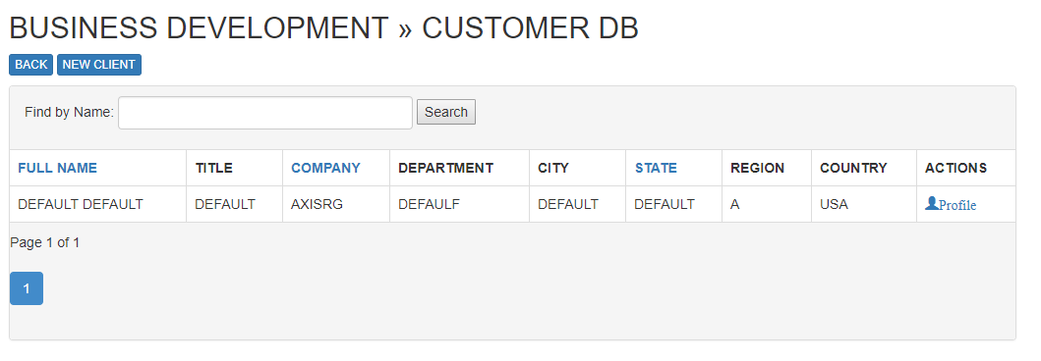
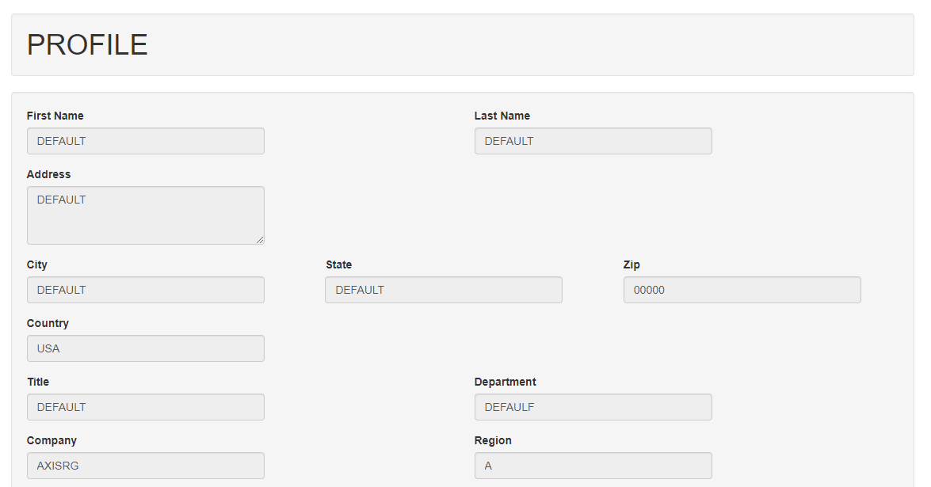
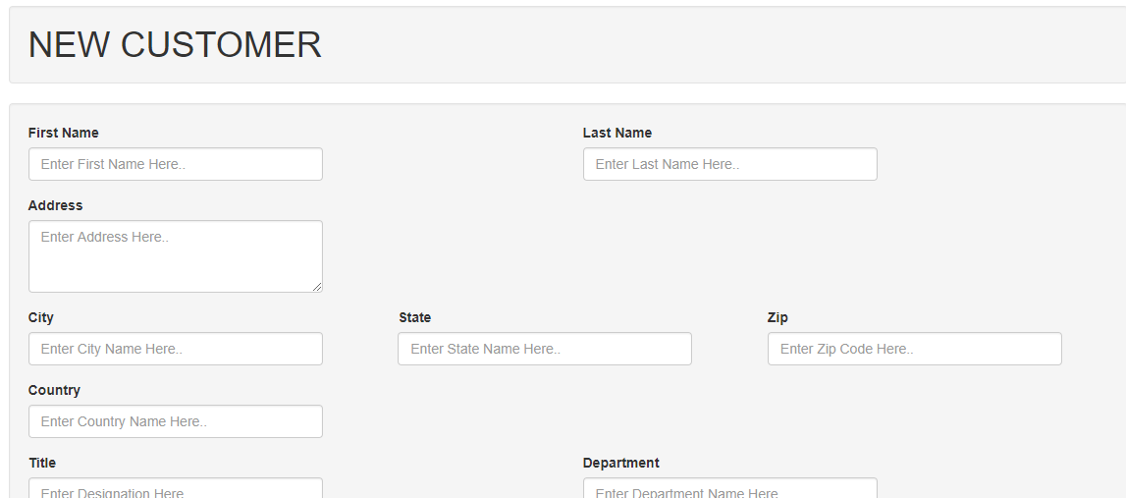
Business Development Add Clients
Options:
View Profile
New Client
Back to previus menú
Sort list by Name, Company or State, only click on label
List of Clients
View Profile. Allow review and Edit clients profile
B. Add new Client in the system

Slide 10
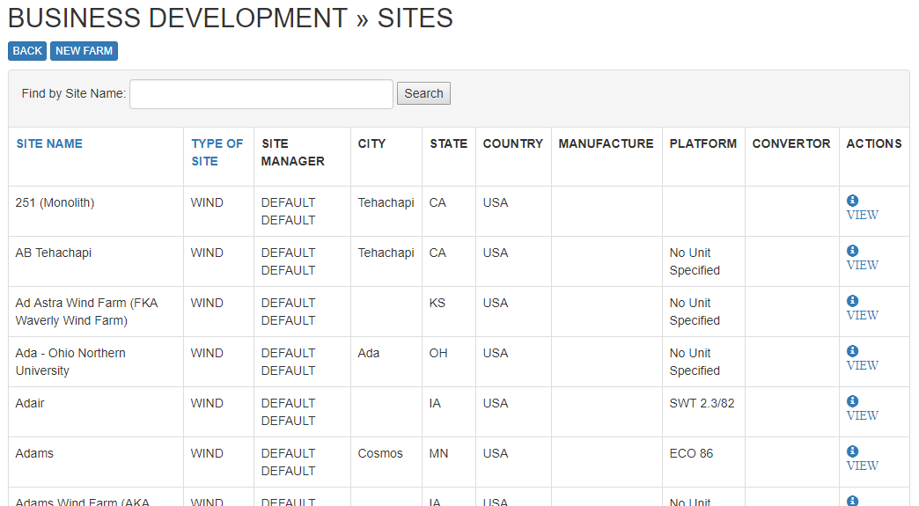
Business Development Link Sites to Clients
Step 1. Register clients into the system. The system only has one Client preloaded “DEFAULT” and this has linked the whole list of sites
Step 2. Link each site to a client
Go to View

Slide 11
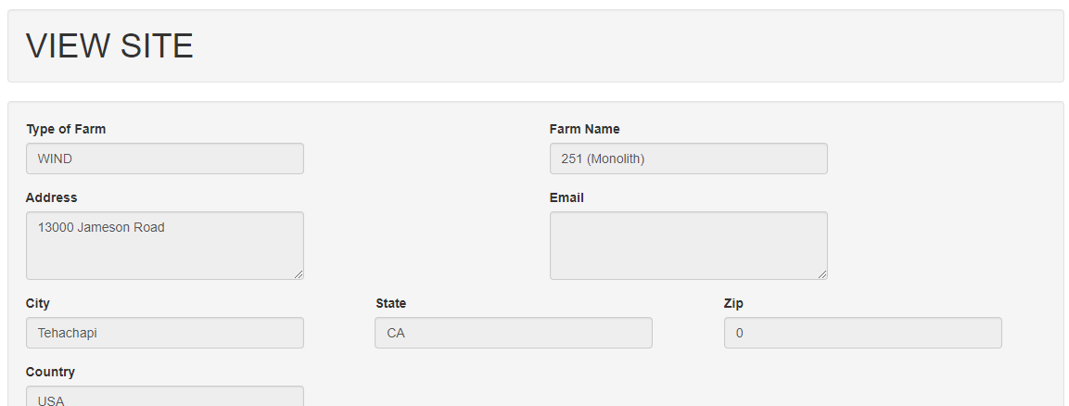
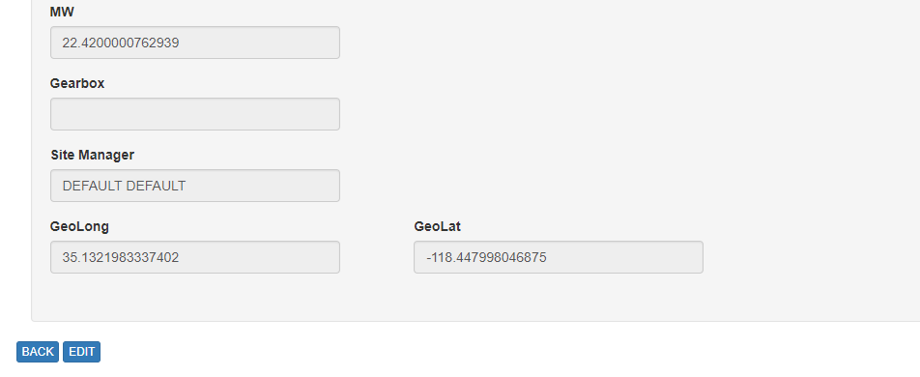
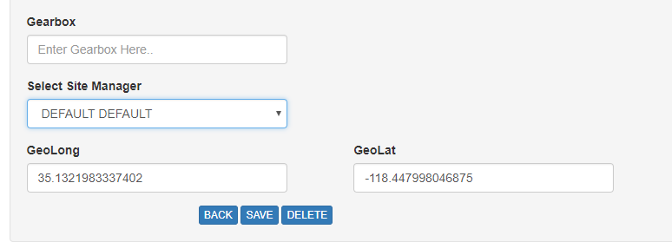
Business Development Link Sites to Clients
1. Scroll down
2. Click on EDIT button
3. Chance the assigned Site Manager and SAVE

Slide 12
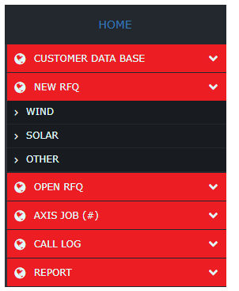
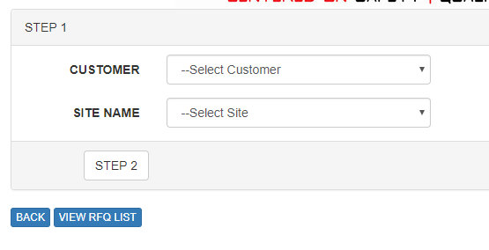
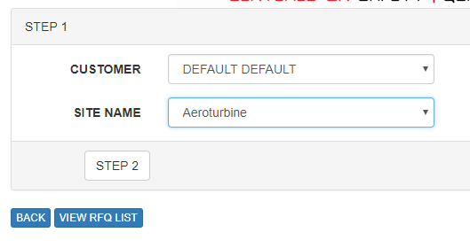
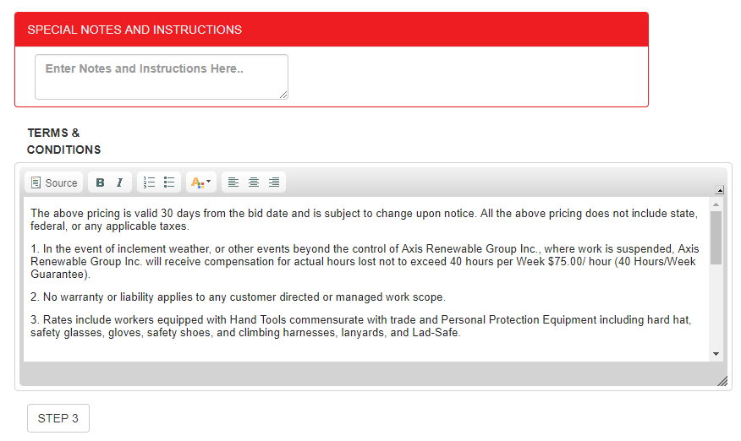
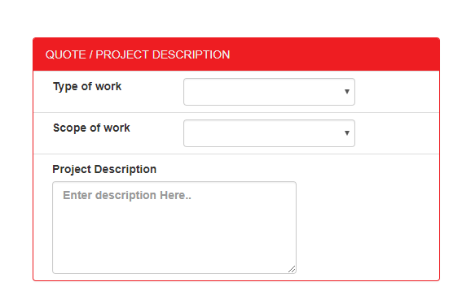
Business Development: Create new RFQ
Step 1. Select one “Customer” from List after selecting a “Site Name”
Go to Step 2
Step 2. Select additional info.: “Type of Work” ,“ Scope of Work”, “Project Description”, Special notes and instructions and Review if “Terms & Conditions” are correct. Go to Step 3

Slide 13
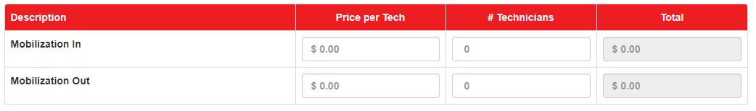
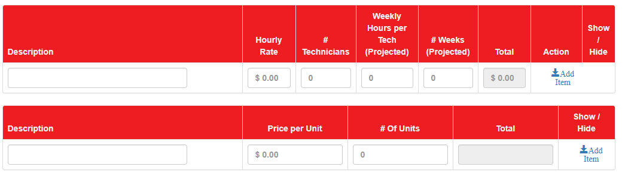
Business Development: Create new RFQ
Step 3. A) Asign “Price per Tech” and “number of Technicians”
Step 3. B) Add ítems by Hourly Rate and/or “Price per Unit”. At the End SAVE VERSION

Slide 14
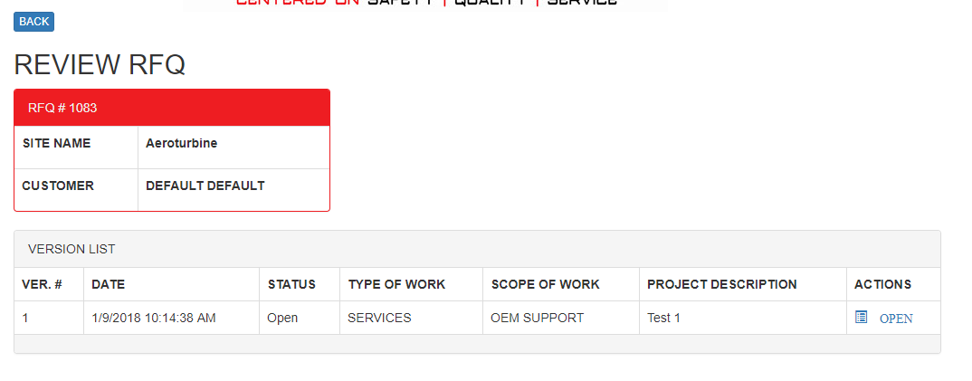
Business Development: Review

Slide 15
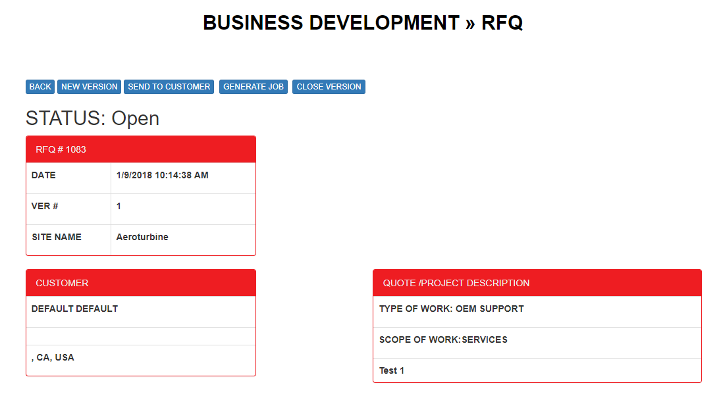
Business Development: Review
Options:
Create New Version. Create version # 2,3, etc..with the same RFQ number
Send to Customer (PDF File). Generate PDF file for send Customer
Convert RFQ To Job. Create New Job # based in this RFQ #
Close versión. Chance the Status of this Version to “CLOSED”

Slide 16
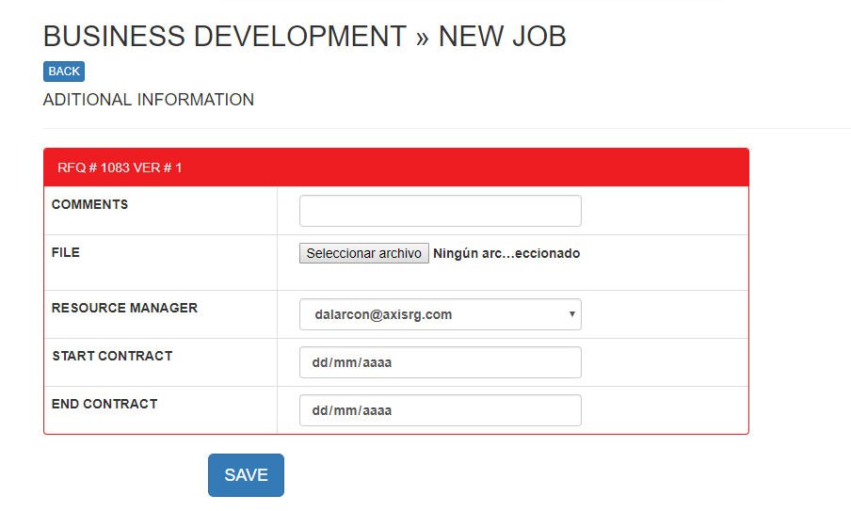
Business Development: Create New Job #
Open RFQ and click on GENERATE JOB
Add Comments, Upload Contract File, asign Resource Manager, Indicate Star and End date of Contract

Slide 17
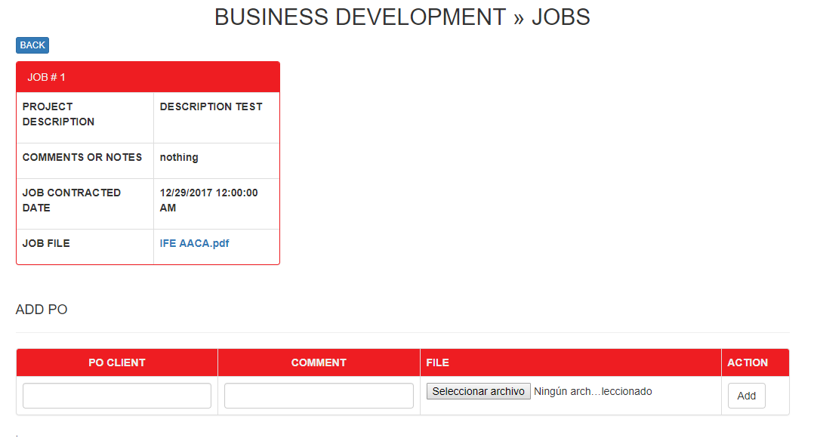
Business Development: Add PO’s to JOB’s
Add PO Client, Comments, upload PO File and click on ADD Button
Note: With Purchase Orders stared the Mobilization Process

